Slide 1
EDA Lab 12
File created on: 08-10-2024 22:00:23

Slide 2
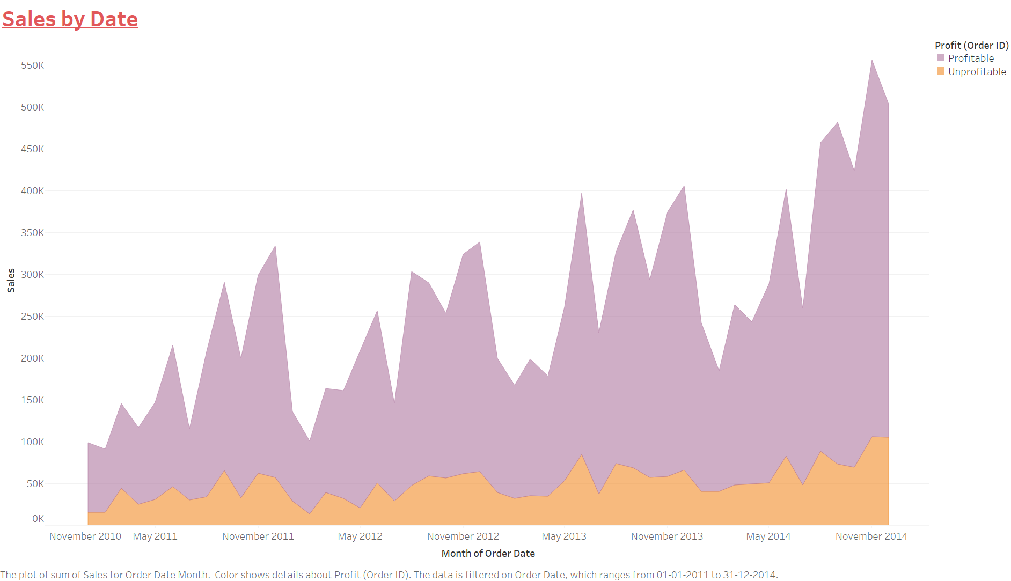

Slide 3
